Slide 1
Introduction to Moelcular Networks in Virology
… and other topics of interest to virologists
Pierre M Jean Beltran

Slide 2
Dynamic regulation of Molecular Networks in Biology
DNA
Epigenome
(e.g., histone occupancy,
histone acetylation)
Transcriptome
(e.g., mRNA abundance,
mRNA processing)
Proteome
(e.g., protein abundance, PTMs, interactions)
Metabolome
(e.g., abundance of lipids, metabolites, and signaling molecules)
Phenotype

Slide 3
A protein-centric view of molecular dynamics
Transcriptome
Proteome
Metabolome
Localization
Post-translational
modifications
Protein X
Interactions
Protein X
Protein X
A
B
Abundance
Abundance
Translation
Protein X
mRNA

Slide 4

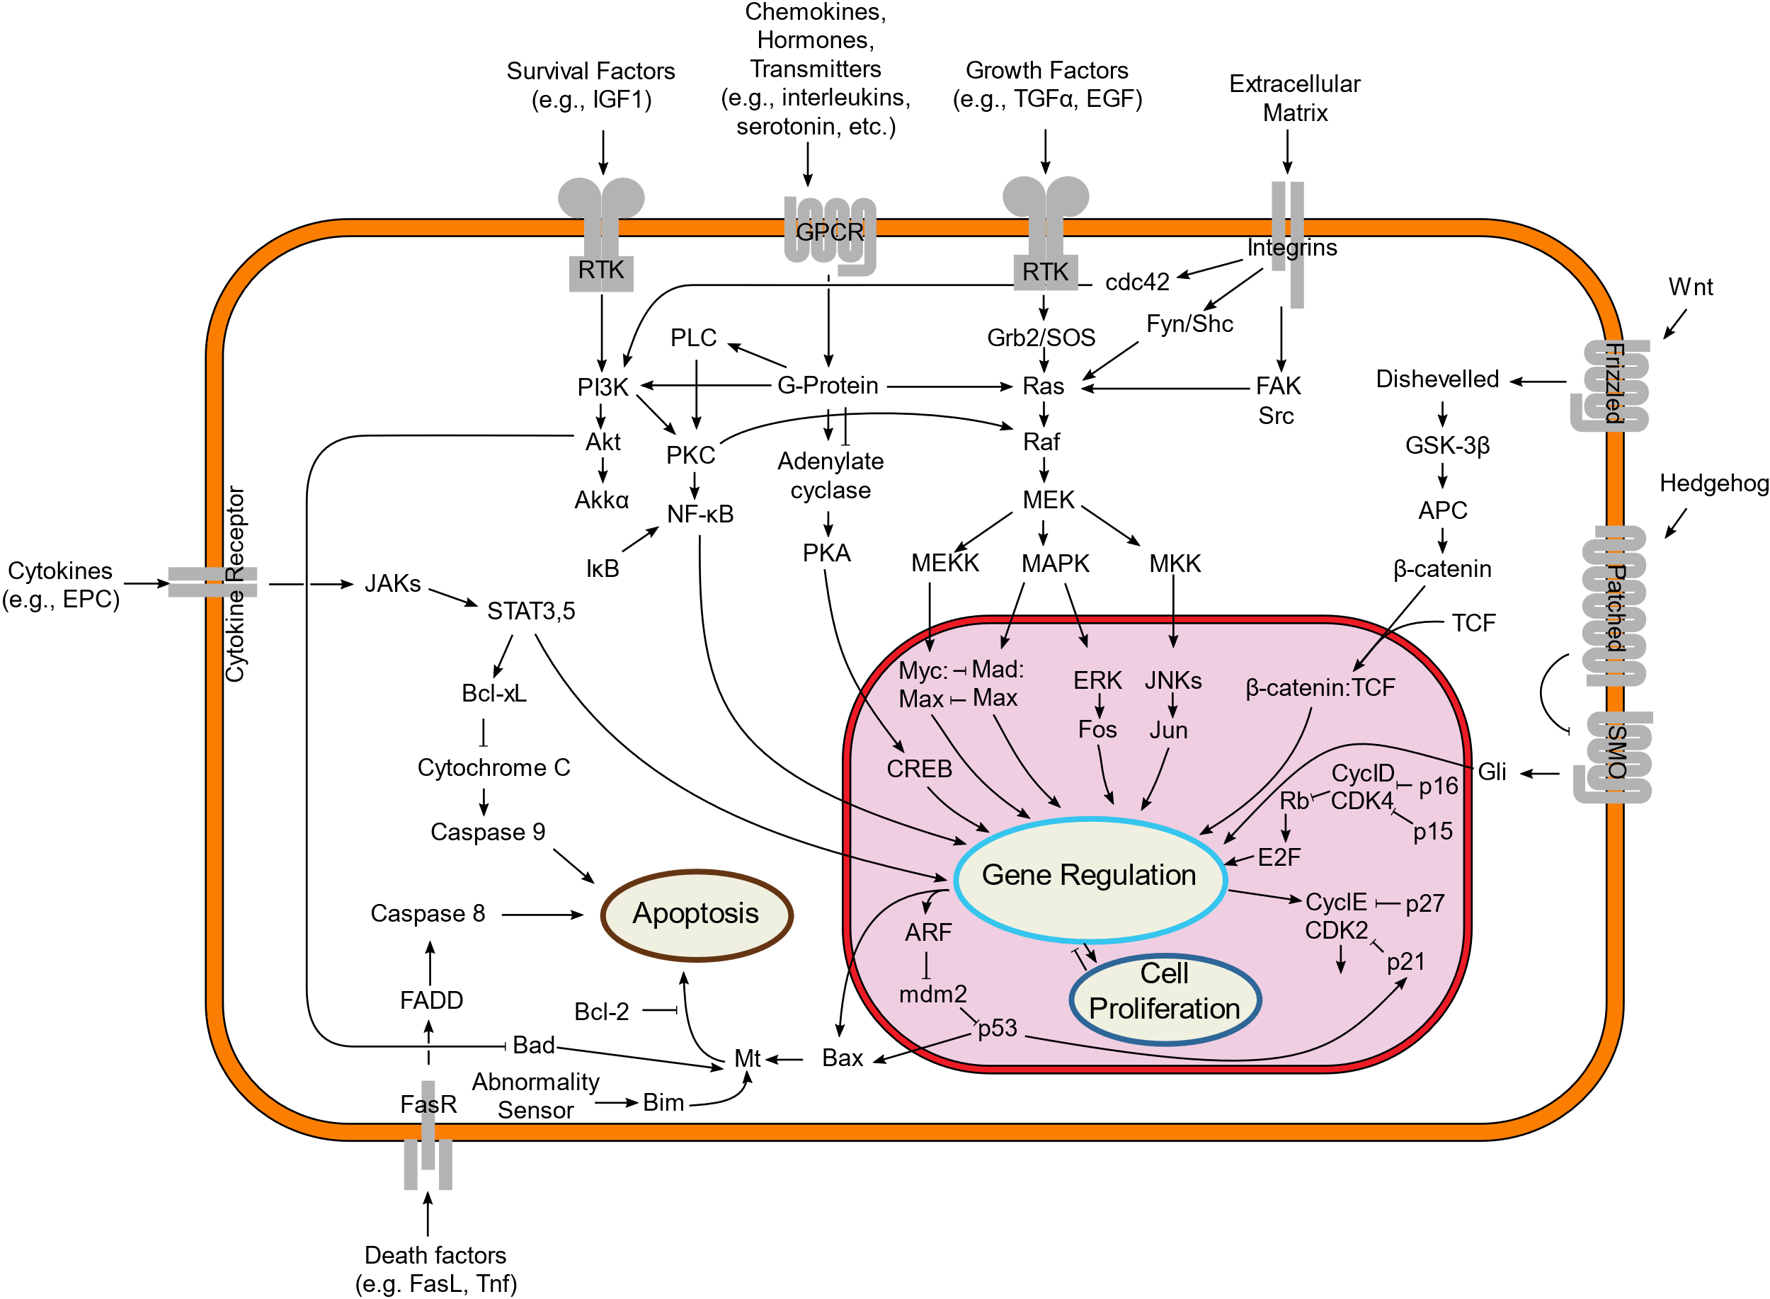
Example of signal transduction in a cell

Slide 5
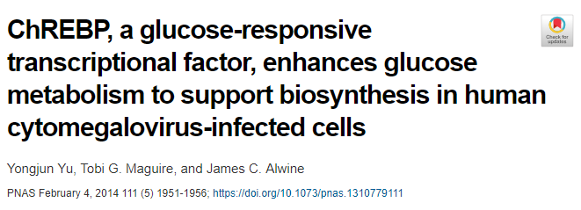
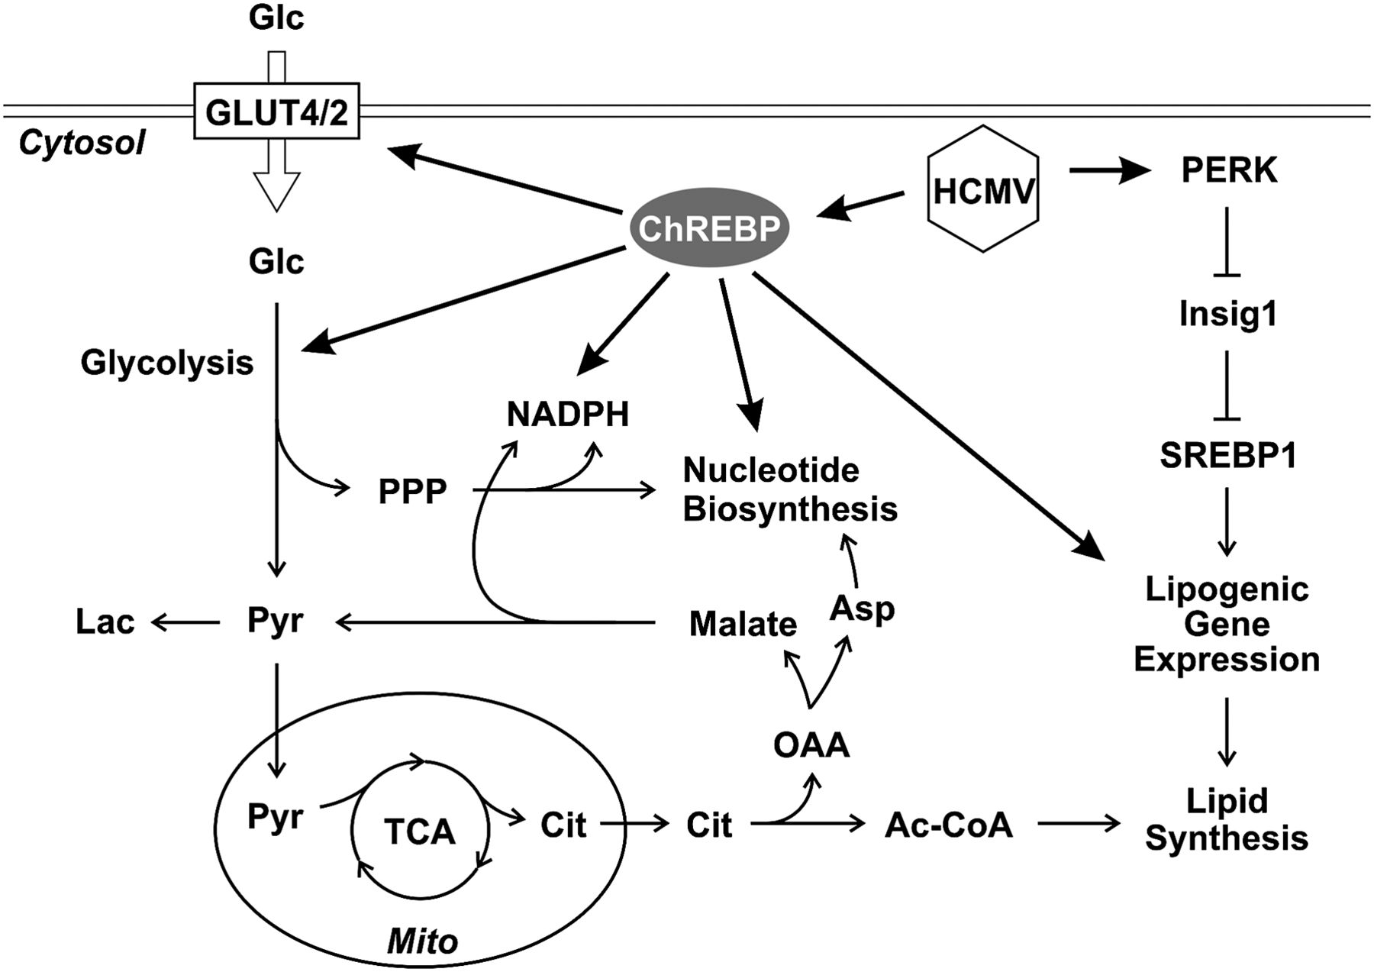
Elucidating molecular networks using a classic molecular approach
HCMV
Replication
Notes:
1. Previous study shows GLUT4 overexpression
2. HCMV induces ChREBP expression
3. HCMV-induced ChREBP expression increases GLUT4 abundance (shRNA of ChREBP)
4. ChREBP is required for lipid synthesis, glucose metabolism, and nucleotide synthesis (shRNA of ChREBP)
5. ChREBP is required for HCMV replication (shRNA of ChREBP)

Slide 6
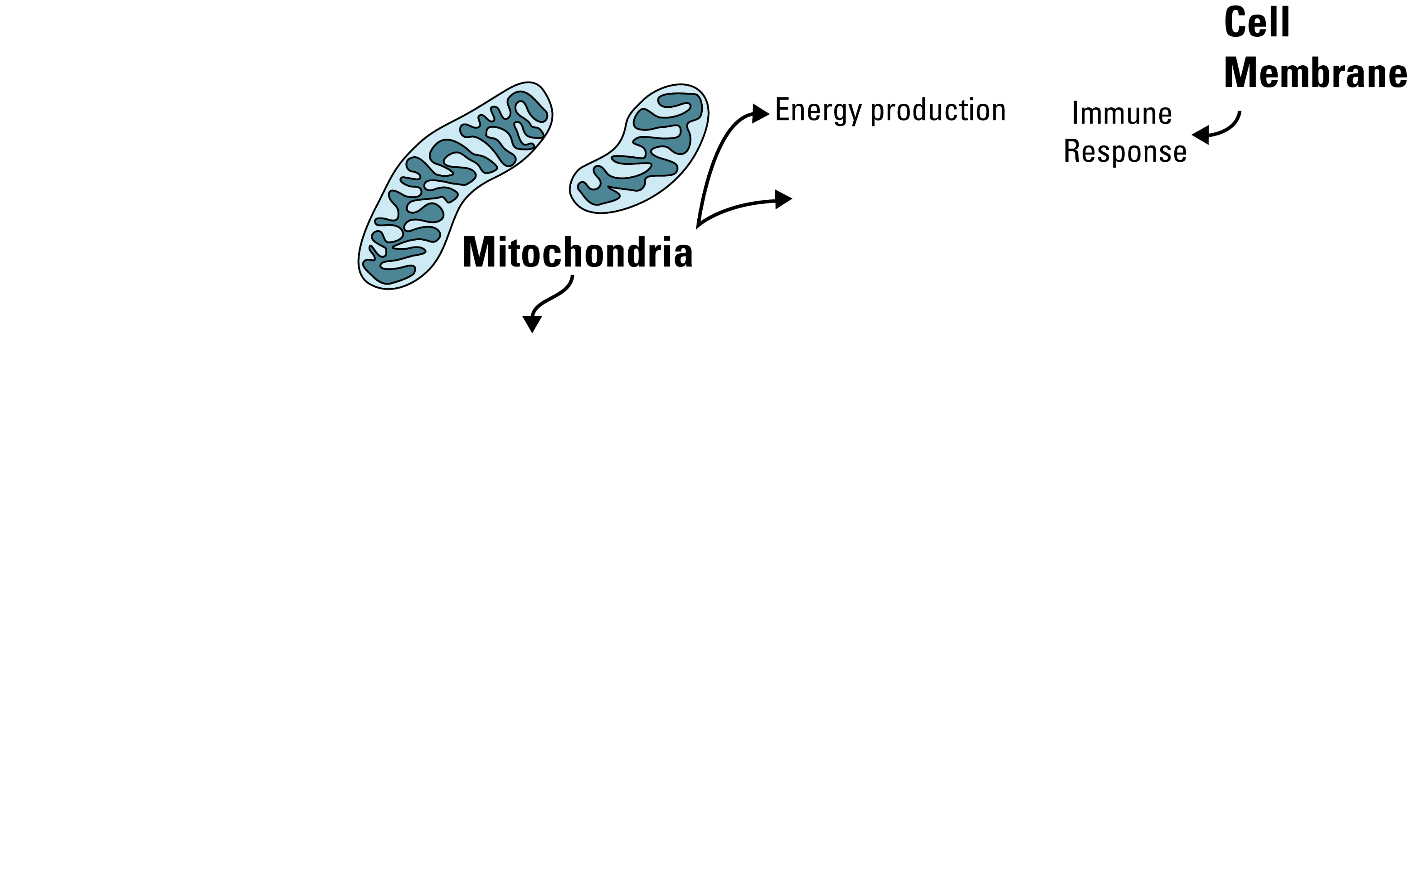
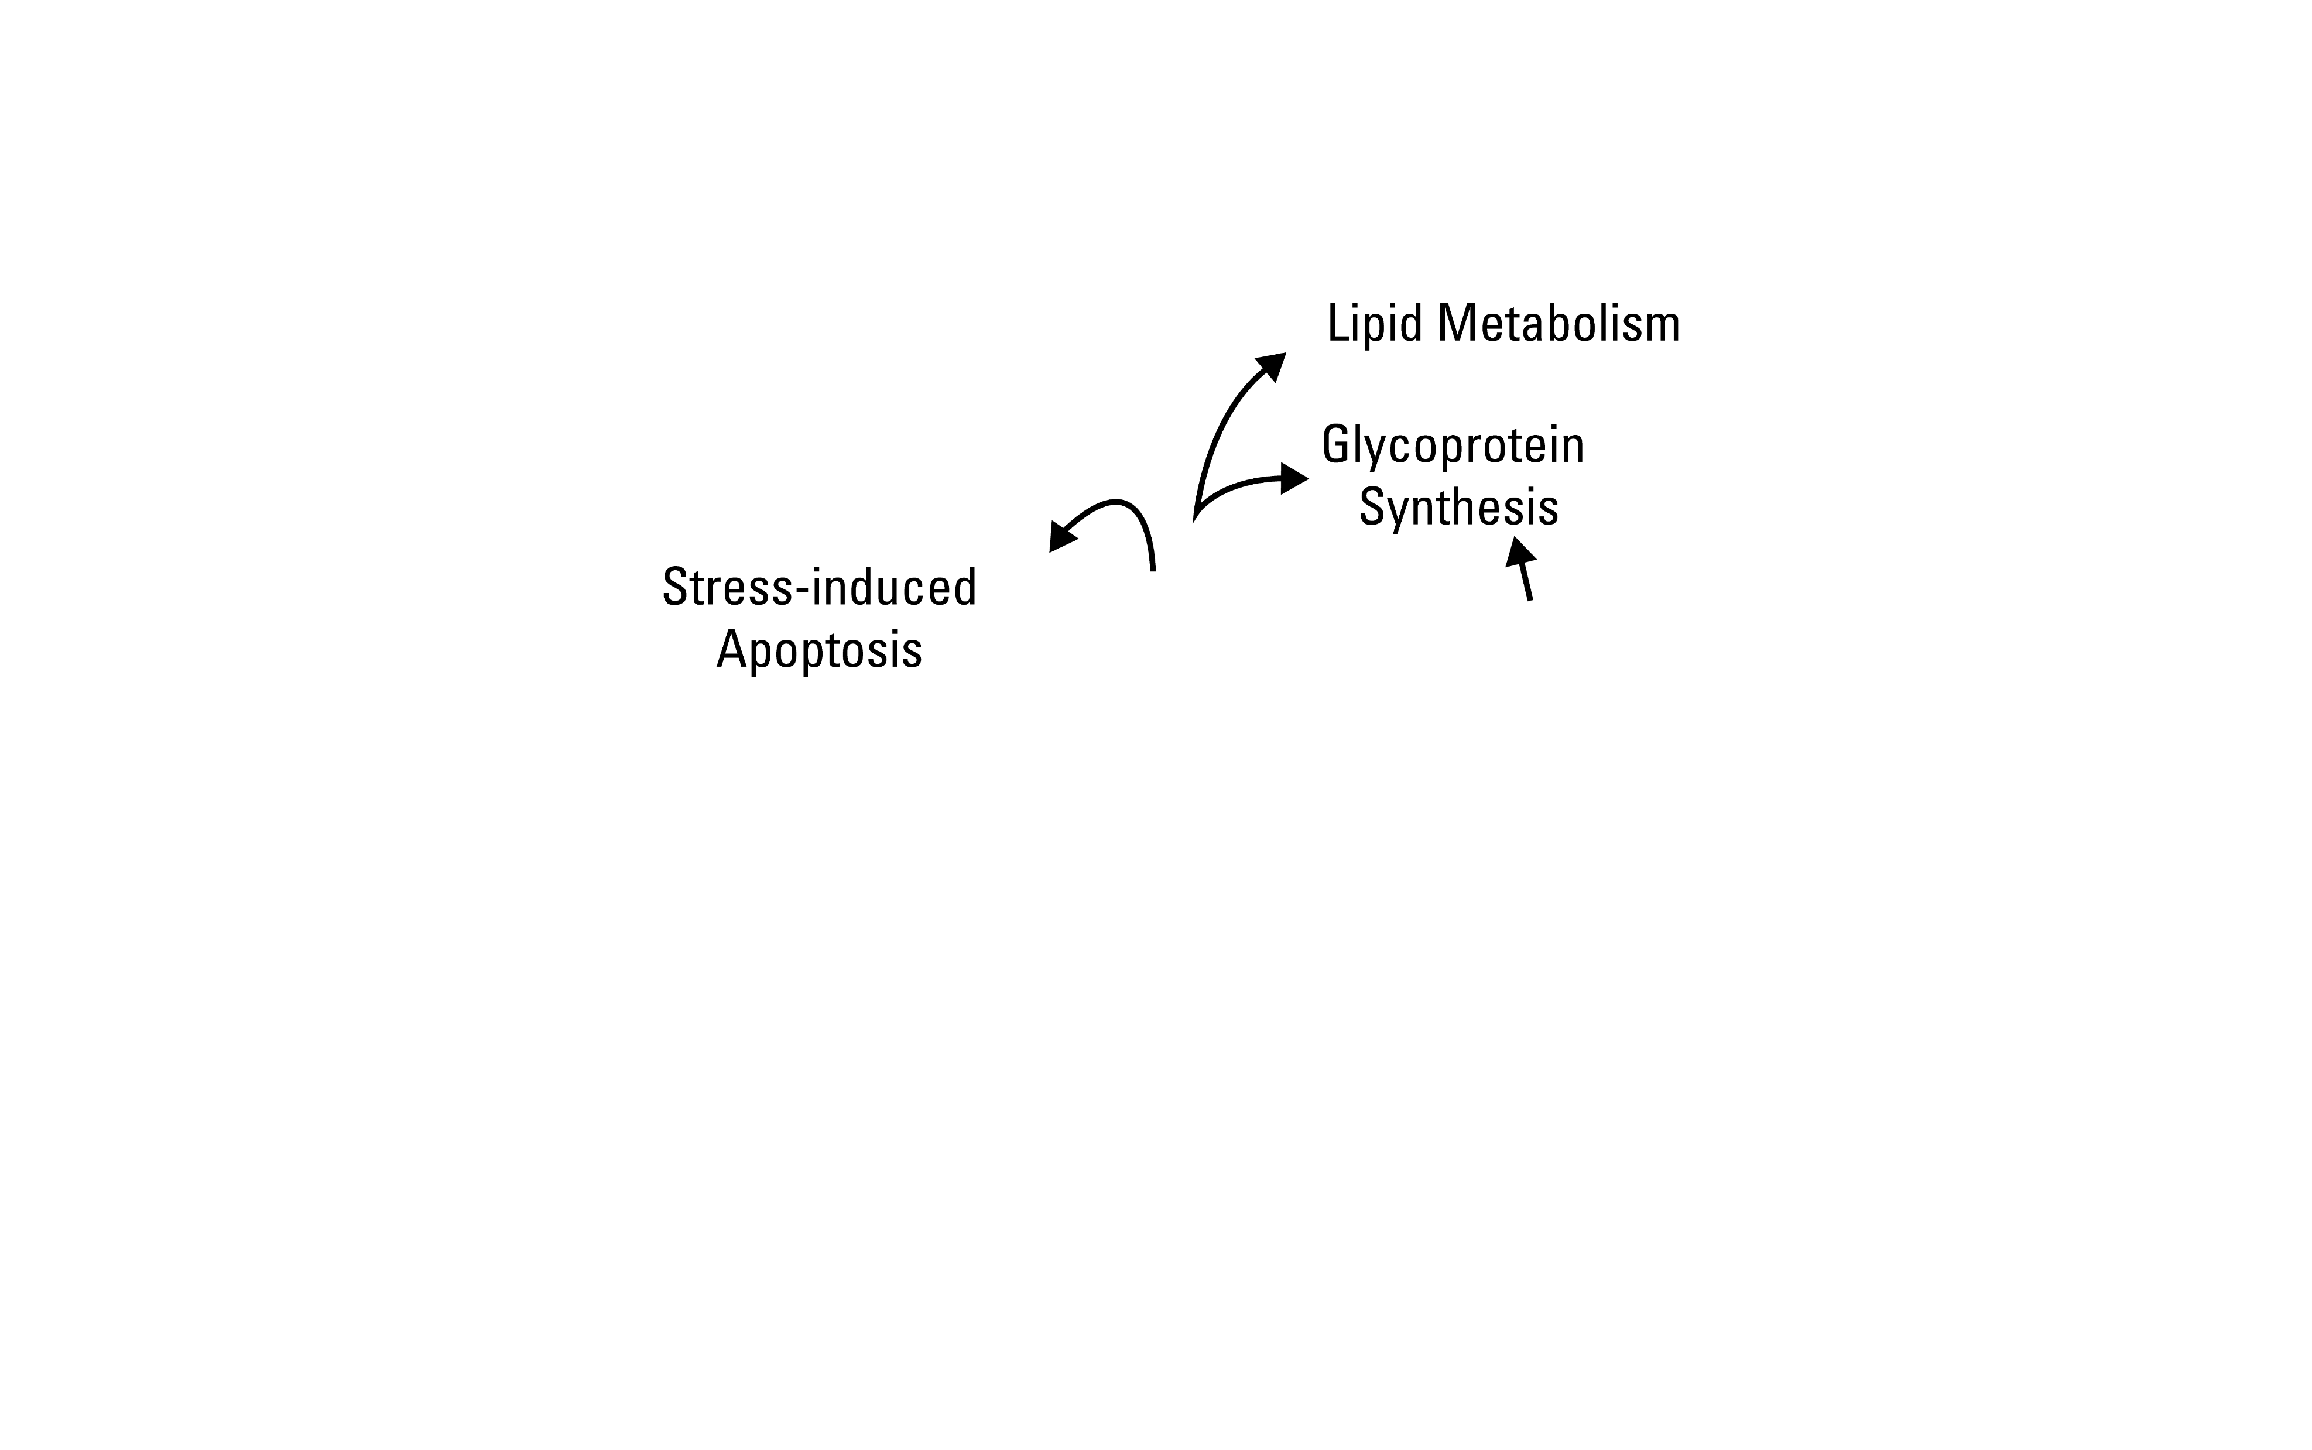
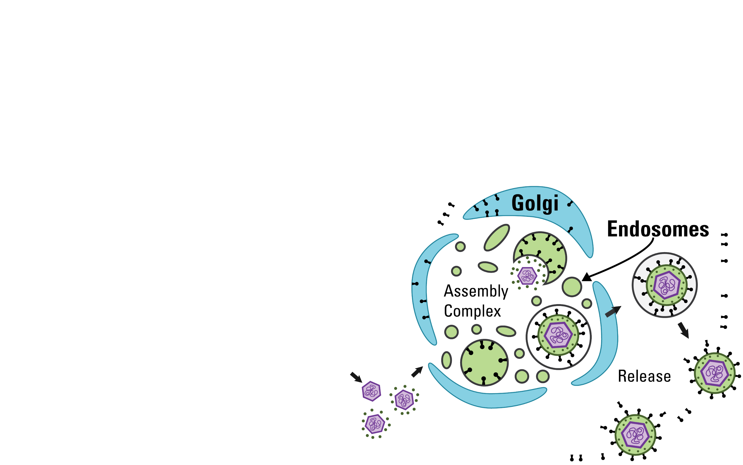
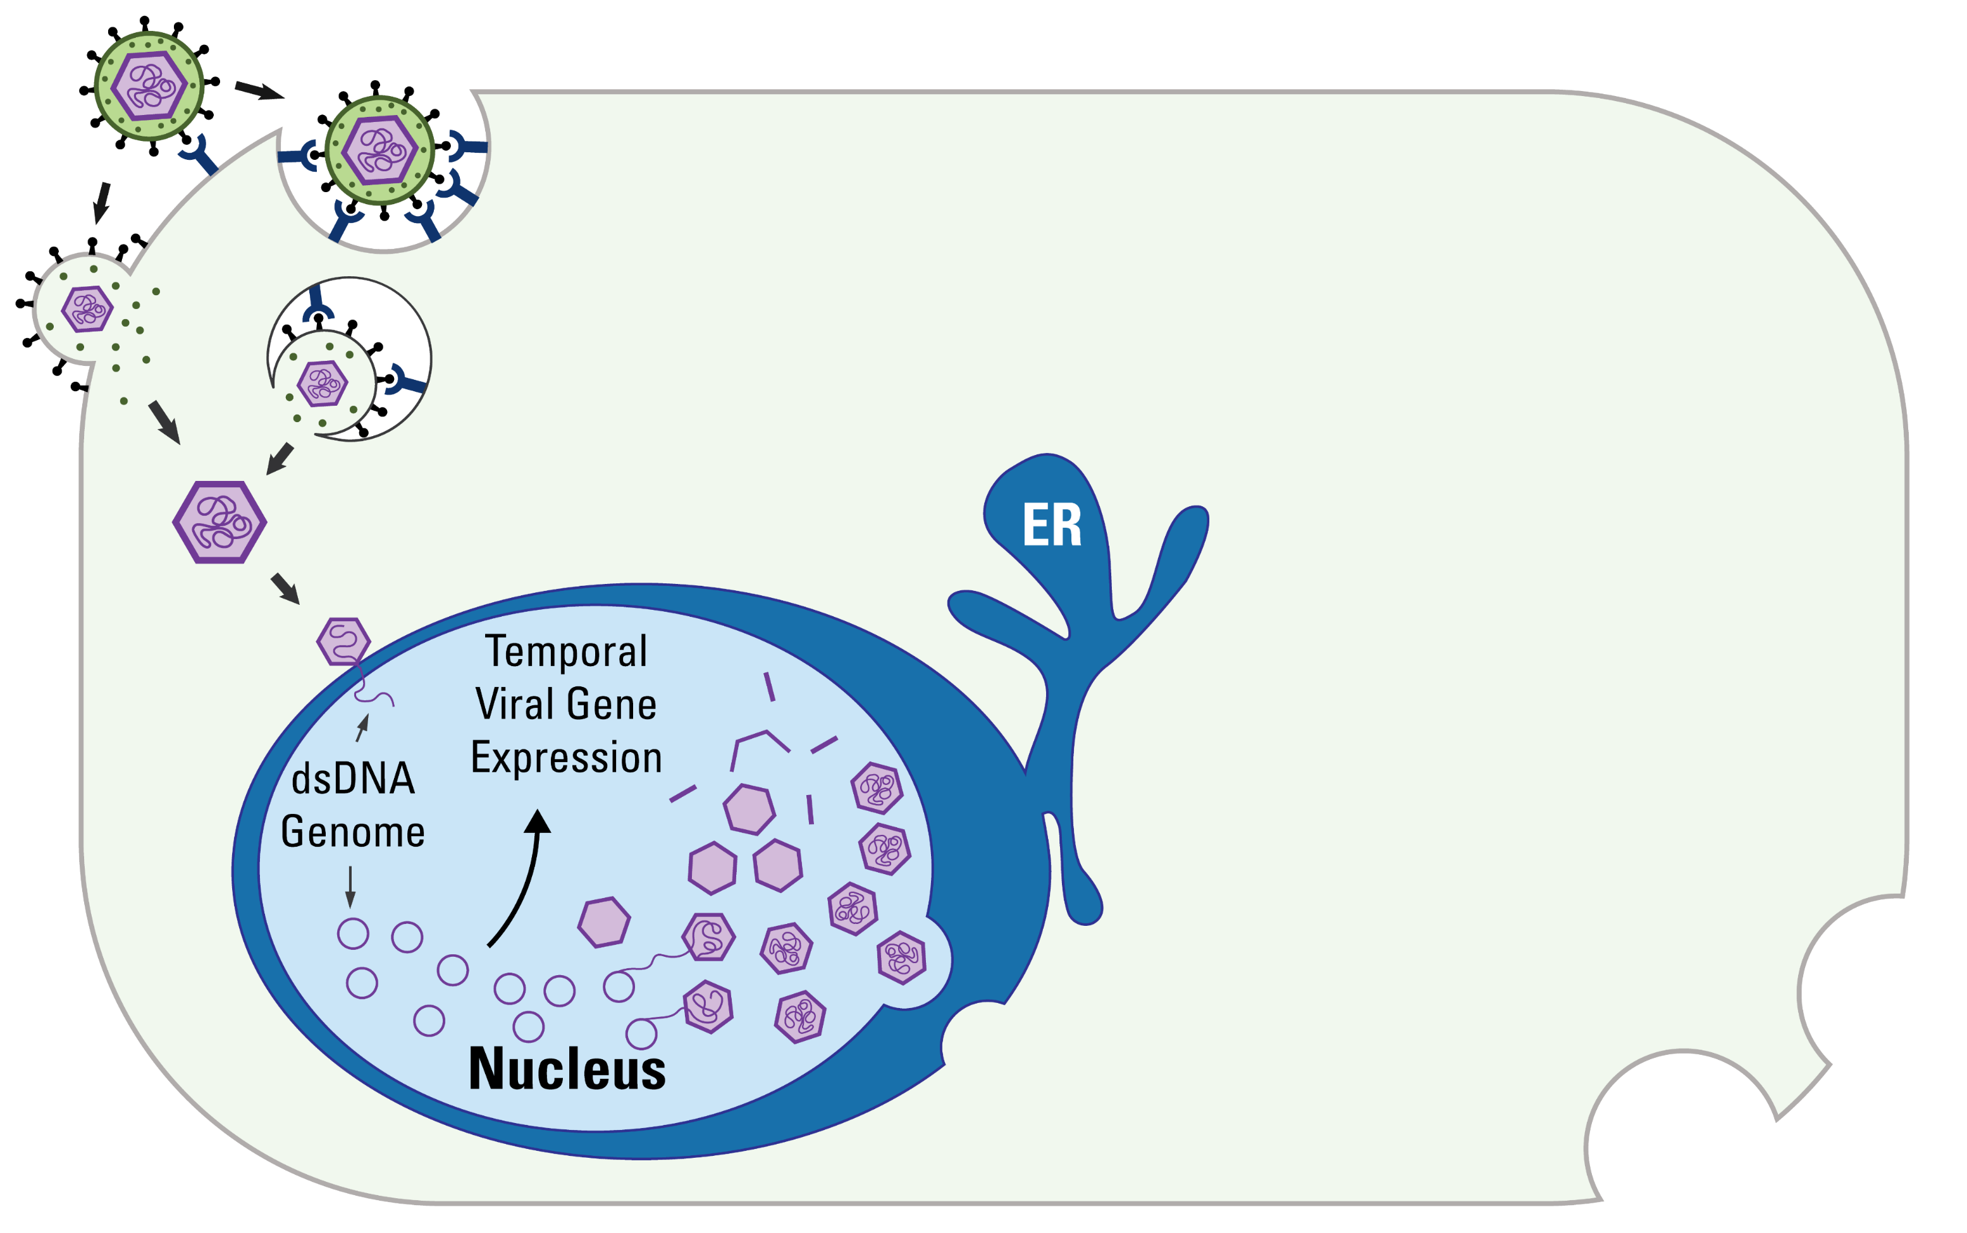
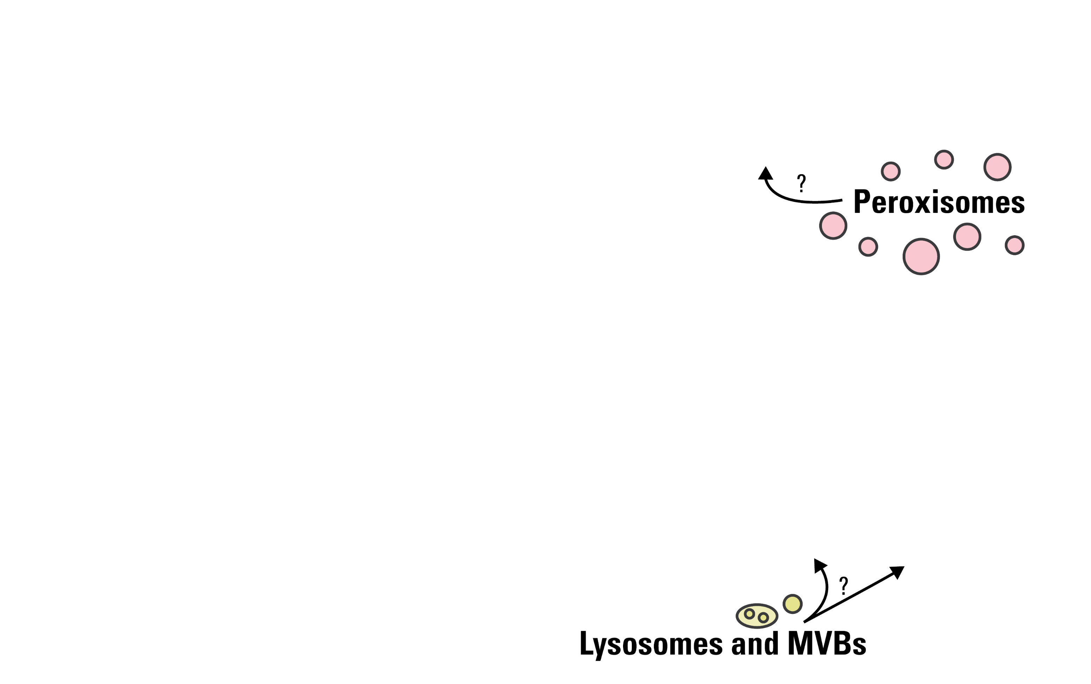
Understanding virus replication

Slide 7
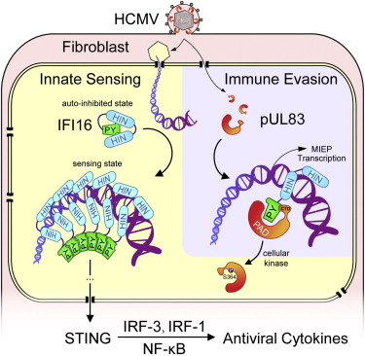
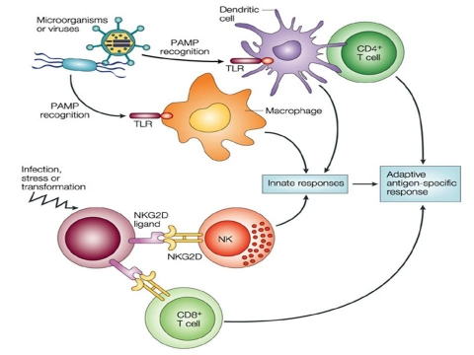
Mechanisms of cell defense
Li T, et al. Cell Host & Microbe. 2013

Slide 8
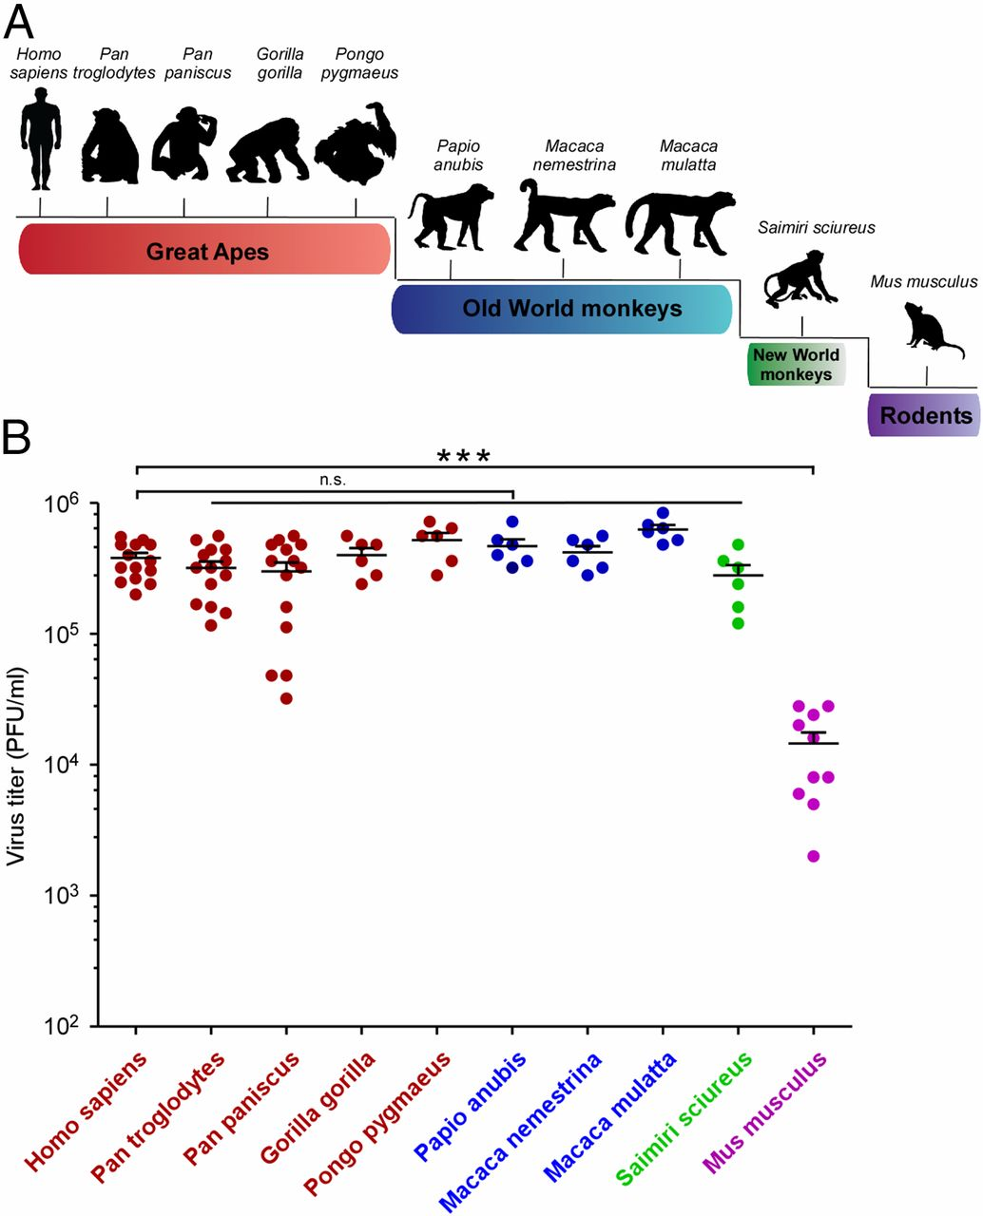
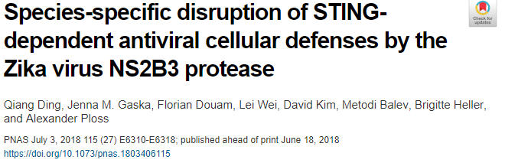
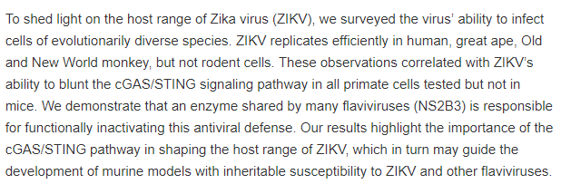
Virus tropism

Slide 9
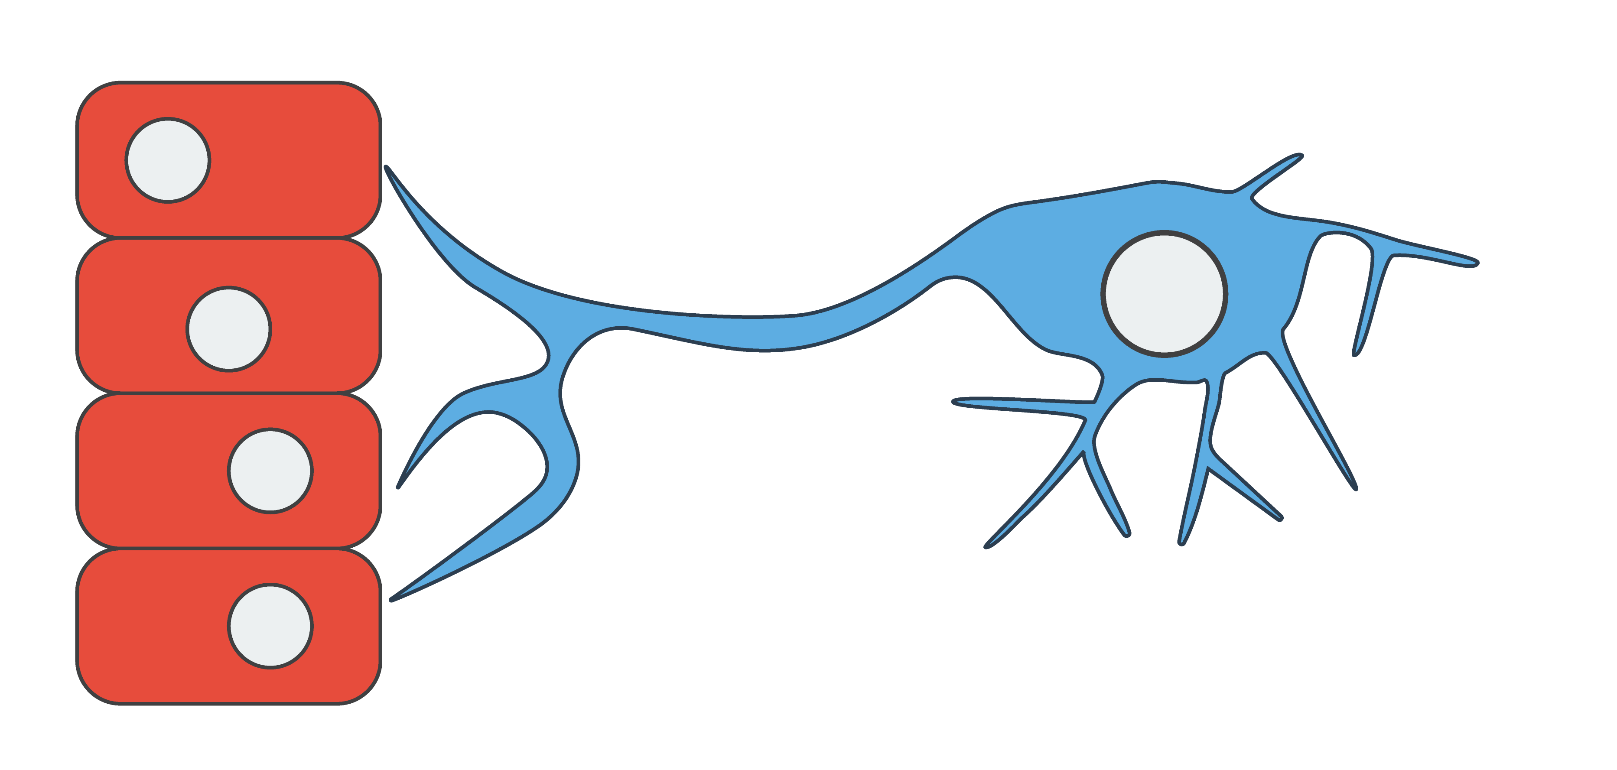



Virus latency and reactivation
Latent repressed
viral genome
Axonal transport
Sensory neurons
Skin layer
Thomas Kristie Lab at NIAID, NIH
Notes:
Virus enters our body skin cells
The DNA viral genome enters nucleus produces new viruses
These viruses infect adjacent neurons transport cell body and deposit genome
However, in neurons latent and repressed
Lasts, throughout the life-time individual

Slide 10
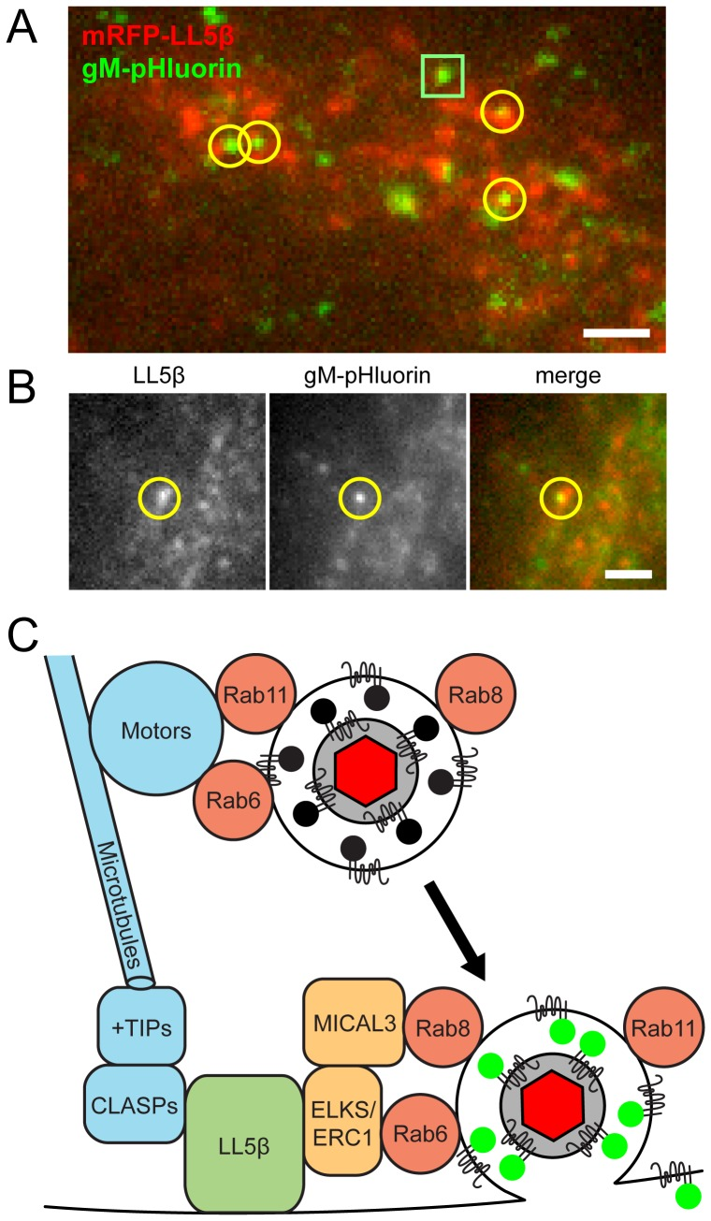
Virus latency and reactivation
Hogue, et al. 2014 PLOS Pathogens
Enquist Lab
Latent repressed
viral genome
Reactivated
viral genome
Stress
signaling
Axonal transport
Recurrent HSV-1 disease
Skin lesions
Blindness
Birth defects
Sensory neurons
Skin layer
Thomas Kristie Lab at NIAID, NIH
Notes:
External stimuli, stress, reactivate dormant virus.
This produces new virus transported and released in skin cells
These cells are infected produce new virus that leads to the chronic diseases causing lesions, blindness, birth defects.
My project aims to elucidate mechanism of reactivation, therefore introduce mechanism viral gene expression

Slide 11
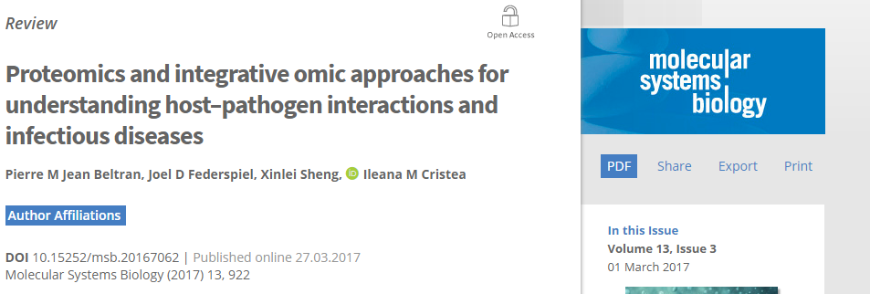
Examples of datasets available
In the context of human cytomegalovirus (HCMV) infection

Slide 12
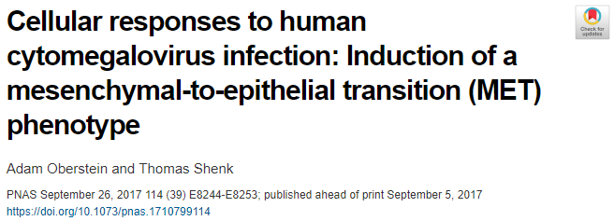
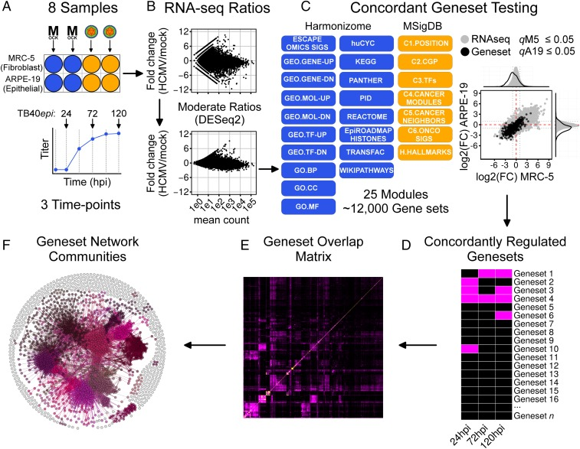
RNA-seq for gene expression data
Identified the induction of MET in epithelial cells
Experimentally determined that a class of early viral genes are responsible for this effect

Slide 13
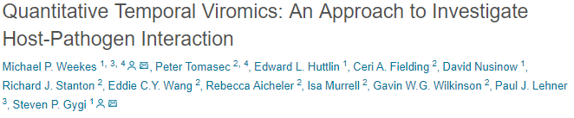
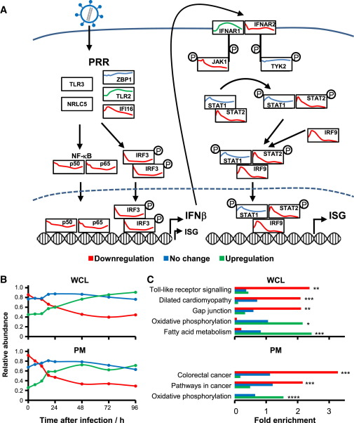
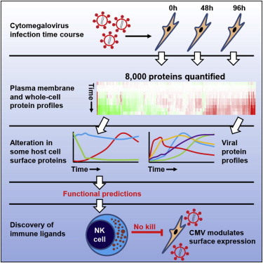
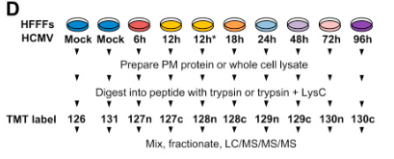
Proteomics data
Notes:
Make point on how this study tries to map these temporal proteome changes to pathways known a priori

Slide 14
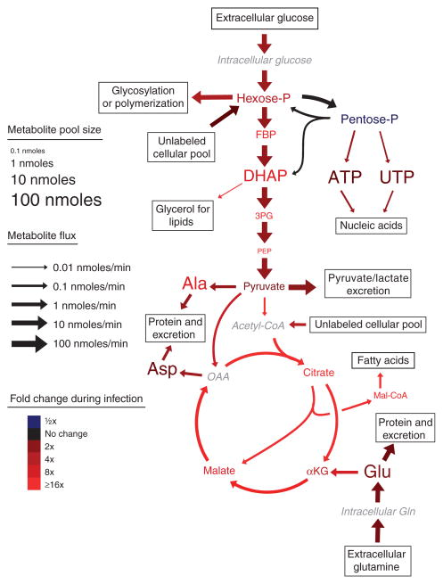
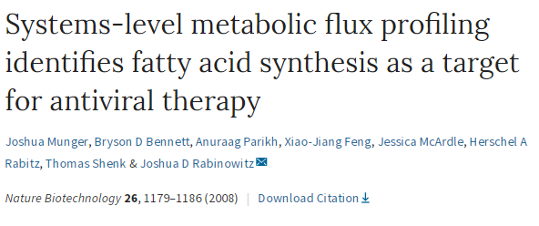
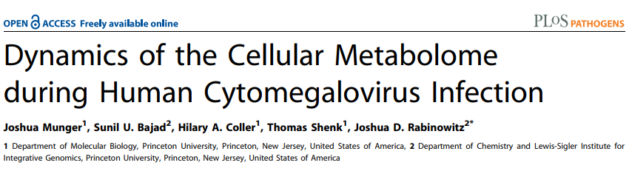
Metabolomics data

Slide 15
Challenges in virology (and maybe other areas)
Most studies focus on a single type of data (proteins, metabolites, etc.)
See Jean Beltran et al. Molecular Systems Biology (2017) for some exceptions
Datasets represent pools of cells (steady-state)
Single-cell RNAseq
CyTOF
Replicate time points

Slide 16
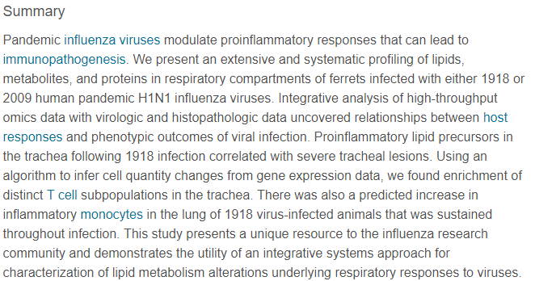
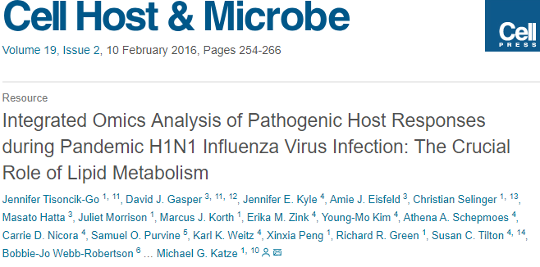
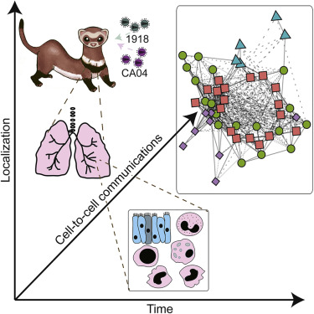
Other datasets
Dataset:
Proteins, lipids, and metabolites
Lung vs trachea
Two virus strains
Three time points

Slide 17

Other datasets (CPTAC; Clinical proteomic tumor analysis consortium)
Dataset:
mRNA, protein, phosphoprotein
108 tumor samples

Slide 18
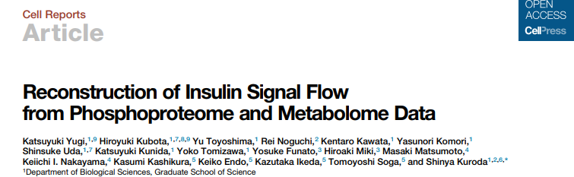
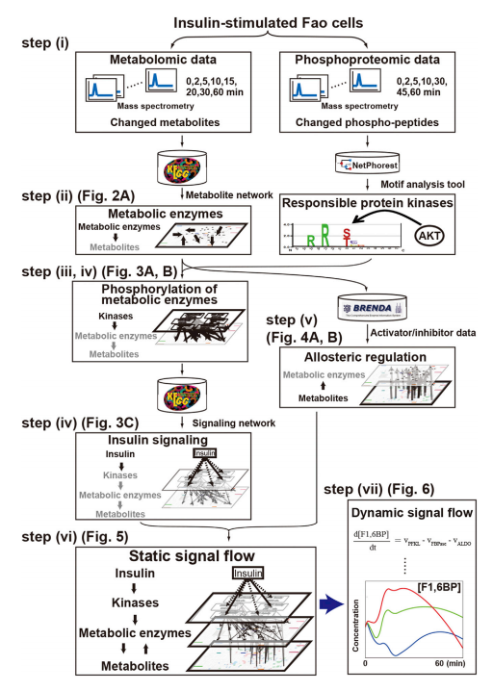
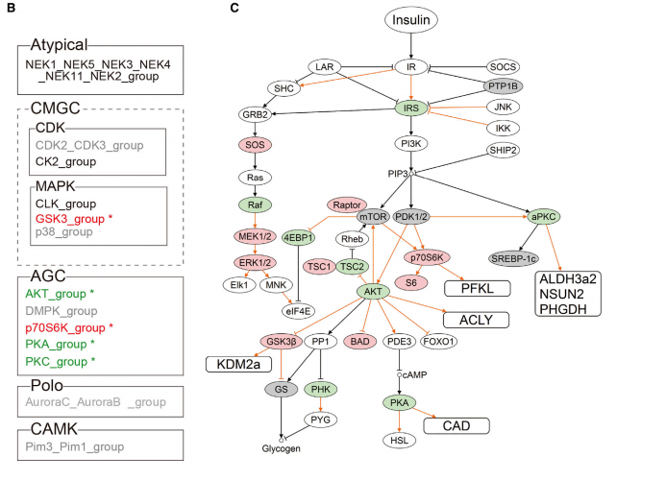
Other datasets

Slide 19
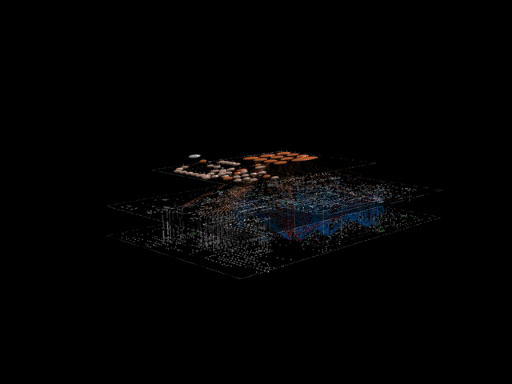

Slide 20
Other datasets: microscopy
Capability to perform live-cell experiments (time-lapse experiments)
Possible to monitor a few proteins at a time (2-5 proteins)
Localization, abundance, interactions
May be possible to combine with other reporter tools
Gene activation, inorganic molecule concentrations (calcium), pH
New technologies:
Super-resolution microscopy (N-SIM)
Lattice light sheet (high speed and minimum photo-toxicity makes it ideal for live samples from cells to full organisms)
Eric Betzig at Janelia
Also available at Harvard
Modeling may be of high interest to developmental biologists and cell biologists (see Ned Wingreen)

